Slide 1
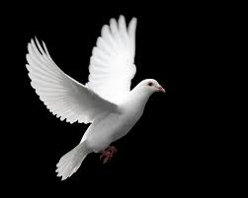
SHALOM - PEACE
Studies of Religion 2014
Presented by
Rabbi David Freedman
of The Central Synagogue

Slide 2
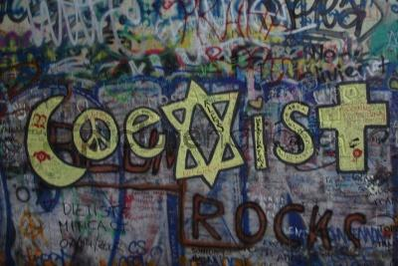
JUDAISM
They shall beat their swords into ploughshares and their spears into pruning hooks; nation shall not lift up sword against nation, neither shall there be war anymore. (Isaiah 2)

Slide 3
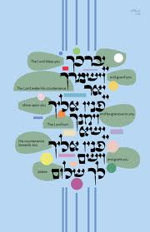
The Bible is filled with longing for peace -
May the LORD bless you and keep you
May the LORD make His face to shine upon you and be gracious unto you
May the LORD turn His face unto you and give you PEACE. (Numbers 6)

Slide 4
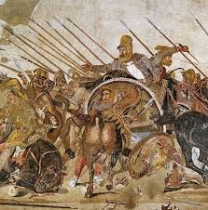
Before declaring a war, there must be an attempt to make peace
“When you draw near to a city to wage war against it,
you shall call out to it for peace”
Deuteronomy 20:10

Slide 5
According to the Mishnah – one of the three foundations of the world is peace (the other two are justice and truth).
One must do all that is possible to foster Shalom Bayit, a home of peace and harmony.
Mipne Darke Shalom – we must extend a hand of friendship to non-Jews, in order to create goodwill between Jews and people of other faiths.

Slide 6
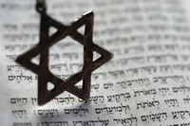
In the Ethics of the Fathers Hillel says: “Be among the disciples of Aaron, loving peace and pursuing peace…” (Ethics of the Fathers 1:12)
In the Midrash Great is peace since all other blessings are included in it. (Vayikrah Rabbah 9) The only reason that the Holy One, blessed be He, created the world was so that there would be peace among humankind. (Bamidbar Rabbah 12A)
In the Amidah (Daily Standing Prayer of 19 blessings) Grant peace, welfare, blessing, grace, loving-kindness, and mercy unto us and unto all Israel, your people.

Slide 7
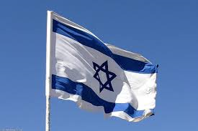
In Israel’s Declaration of Independence We extend our hand to all neighboring states and their people in an offer of peace and good neighborliness, and appeal to them to establish bonds of cooperation ... with the sovereign Jewish people settled in its own land. The State of Israel is prepared to do its share in common effort for the advancement of the entire Middle East.
In the prayer for the State of Israel Please bless the State of Israel…spread over it the shelter of Your peace. Grant peace unto the land, lasting joy to its inhabitants. Remove from us all hatred and hostility, jealousy and cruelty. And plant in our hearts love and friendship, peace and companionship. Speedily fulfill the vision of Your prophet: “Nation shall not lift up sword against nation, neither shall they learn war anymore.”

Slide 8
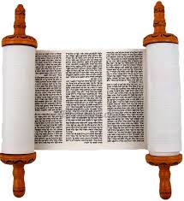
Its ways are ways of pleasantness
and all its pathways are peace. (Proverbs 3:17)

Slide 9
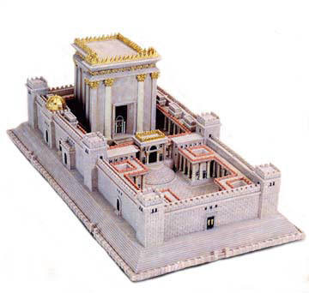
King David was a warrior king, a poet and a singer; according to the Talmud he was also a great scholar, but in spite of all these qualities, David was not allowed to build the Temple in Jerusalem. The reason given - he was a man of war rather than a man of peace. David’s son and heir Solomon, (whose Hebrew name Shlomo is derived from the word Shalom), was however considered a man of peace. It was King Solomon therefore, who was given permission to build the Holy Temple, God’s house of peace.
Metal, being the material from which weapons of war are generally made, is forbidden in any form in the construction of the altar. Instead a creature known as the shamir was used to cut the stones.

Slide 10
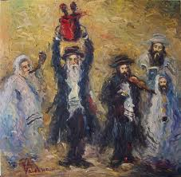
The Hebrew word for peace, Shalom, does not mean a cessation of war, it comes from the word shalem – complete, fullness or perfection.
There are three levels of perfection of relationships:
Between man and himself – the achievement of inner peace, a sense of personal contentment.
Peace between a Jew and his fellow Jew. The destruction of the Second Temple occurred because of Sinat Chinam – wanton hatred. It is believed that the Messiah will not arrive and herald an era of world peace until Israel is united in the service of God.
Peace between Jews and Other Nations – numerous laws have been enacted specifically to promote peace between Jews and non-Jews. Part of the messianic goal is to promote peace amongst all nations.

Slide 11
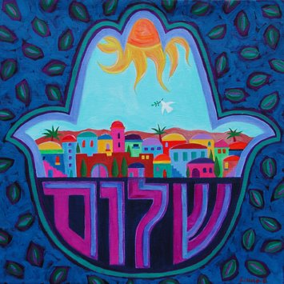
The Hebrew word for peace, ‘SHALOM,’ comes from a root meaning ‘completeness’ and ‘perfection’. So when there is peace in Jewish terms, that means things are perfect: there is calm, security, prosperity and a general feeling of physical and spiritual well-being. It doesn’t just mean there is no war.
In Hebrew, to ask someone how they are (“How are you?”) we say “Ma shlomcha?” ‘Shlomcha’ literally means ‘your peace’, so we are actually asking them “How’s your state of peace?” This shows how important living in a state of peace is in Jewish thinking.

Slide 12
INNER PEACE
The sacred texts of Judaism state that Jews can only achieve inner peace if they commit themselves to God. Great is peace, for God’s name is Peace. One way of committing oneself to God is by being a true follower of the Torah.
One way of achieving inner peace is by following the teachings of the Torah. If one submits oneself to study the ways of the Torah and follow its paths, a person will subsequently achieve inner peace, as the Torah’s ways are ‘pleasant’ and ‘peaceful’.
The rabbis teach, ‘To the degree that one toils in Torah, to that degree does he merit Taharah (Spiritual purity).’ The further one delves into the Torah and follows its commandments, and the more one submits oneself to God, the more achievable is inner peace.

Slide 13
The Jewish obligation to pursue peace
Peace is so important a concept in Judaism that Jews have a religious obligation to pursue it. “Seek peace, and pursue it' ‑ seek it in your own place, and pursue it even to another place as well.” Leviticus Rabah 9:9
We are told that “He who establishes peace between man and his fellow, between husband and wife, between two cities, two nations, two families or two governments…no harm should come to him.” Mekhilta Bahodesh
One may deviate from the truth for the sake of peace...it is permissible to utter a falsehood for the purpose of making peace between a man and his fellow.
Talmud Bavli Yevamot 65b

Slide 14
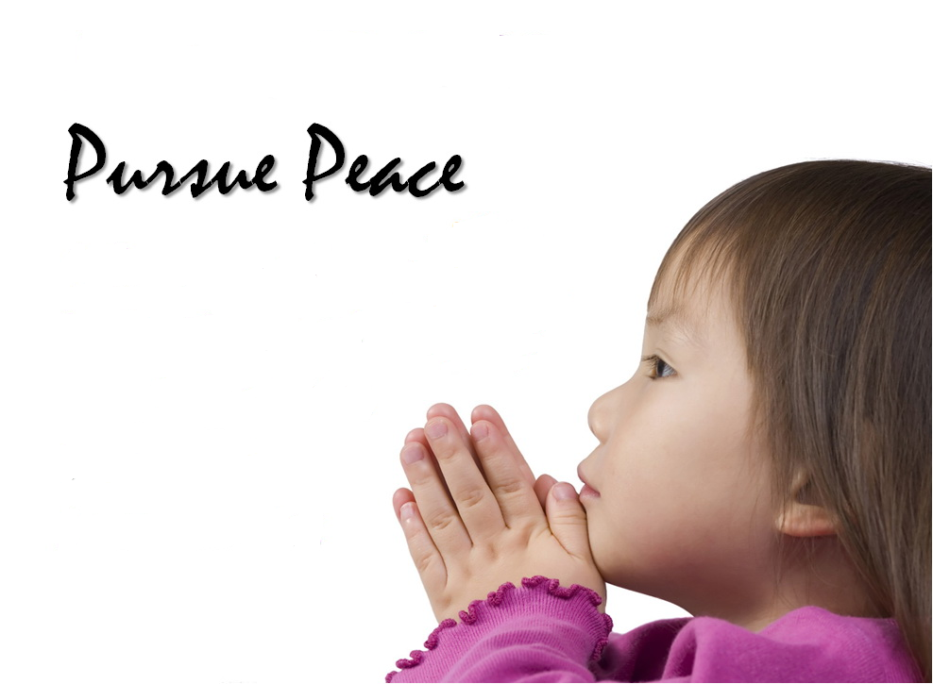
Be among the disciples of Aaron: love peace and pursue peace; love all fellow creatures, and bring them near to the Torah.
Hillel - Pirke Avot

Slide 15
